Slide 1
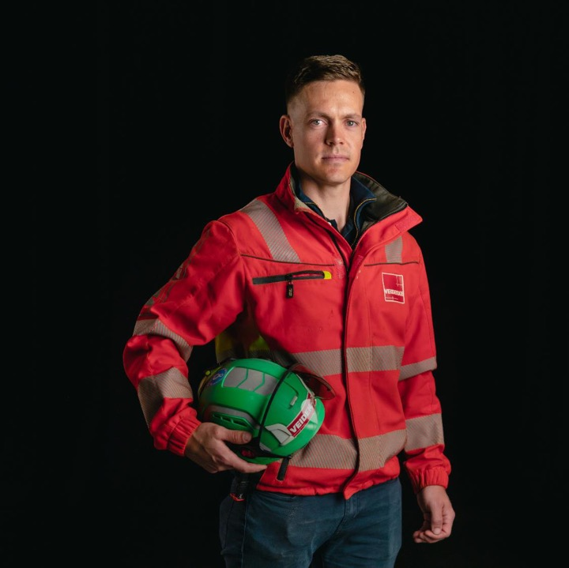
Veidekke’s HSE week 2023:
The Six Major Hazard Areas
Veidekke’s HSE week 2023

Slide 2
How to implement a joint programme?
Introduction to this year’s topic, feel free to use this PowerPoint presentation (5 minutes)
Play this year’s HSE week film on the big screen, optionally via mobile phone (15 minutes)
Carry out the reflection tasks in small groups. Get into groups of twos or threes. Then discuss the answers in a plenary session. (Set aside sufficient time – at least 40 minutes)
The joint programme takes approximately 60 minutes to complete.

Slide 3
What are Veidekke’s HSE objectives?
No one should become ill, injure themselves or, in the worst case, lose their life as a result of working at or for Veidekke. The main priority is to put an end to the serious injuries.
An important prerequisite for good HSE is good production and the active involvement of all employees. Veidekke will continuously work on improvements to the company’s systematic HSE work.
Our workplaces will be characterised by high job satisfaction and zero tolerance for bullying and harassment. Everyone should be treated equally and with respect.

Slide 4
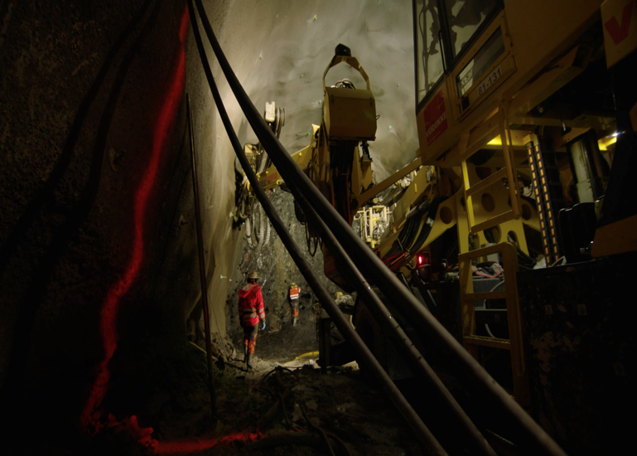
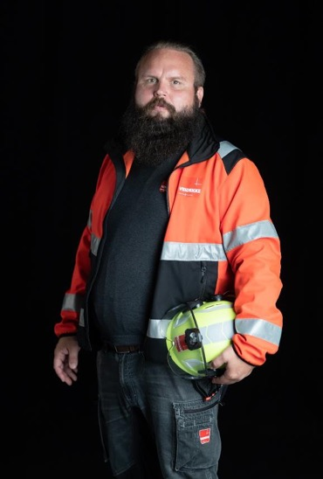
The topic for HSE Week 2023
The six major hazard areas in the construction industry

Slide 5
Three prerequisites for being able to carry out the job with the lowest possible risk
1. Planning. Good planning from design to implementation can reduce risk. Realistic time frames and good dialogue between the professional units that plan and those who carry out the work make it possible to work in a safer way.
2. Barriers. In the construction industry, workplaces constantly change, and there is a big difference between theory and practice. Barriers are there to prevent dangerous situations and provide physical obstacles that limit the chances of accidents taking place.
3. Behaviour. The Norwegian Labour Inspection Authority’s annual reports show that behaviour was one of the causes in 84 percent of the most serious accidents in the construction industry. Therefore, it is important to be aware of all factors that affect your ability to pay attention and concentrate.

Slide 6
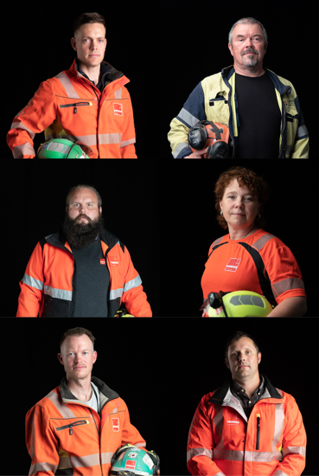
Every project is different. But the risks are the same. The six major hazard areas in the industry are:
Falling objects
Large vehicles
Electric currents
Blasting/explosions
Falls from heights
Crushed/trapped

Slide 7
Watch the video

Slide 8
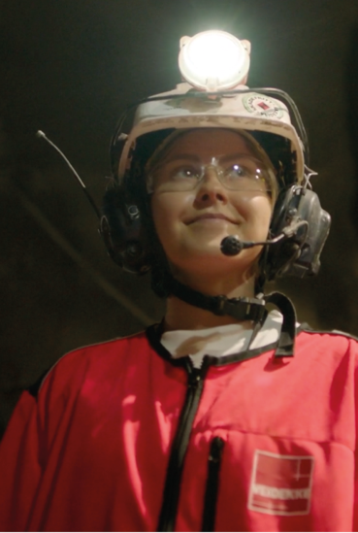
Reflection tasks after the video
Spend sufficient time on this part, at least 40 minutes
Get into groups of twos or threes
Carry out the reflection tasks
Then discuss the answers in a plenary session

Slide 9
Reflection tasks
During a busy workday, we may experience situations where we choose to ignore safety procedures. What could be the reasons why we choose not to follow procedures and respect barriers?
It is human to make mistakes – in fact, you can sometimes be the biggest risk factor in your workplace. What can we do to prevent humans from becoming the weak link in safety work?
A good level of safety depends on interaction between different roles. If one or more people allow an undesirable practice to continue even though one knows it is wrong, this may increase the risk. This is called a ‘silent non-conformity’. Discuss what type of ‘silent non-conformities’ exist at your workplace and what it would take to speak up about this.
Everyone knows what it is like to be pressed for time. Stress and time pressure can push us into taking bigger risks than we should. How can we make better decisions and take fewer risks when we are under pressure?

Slide 10
Takk for

