Slide 1
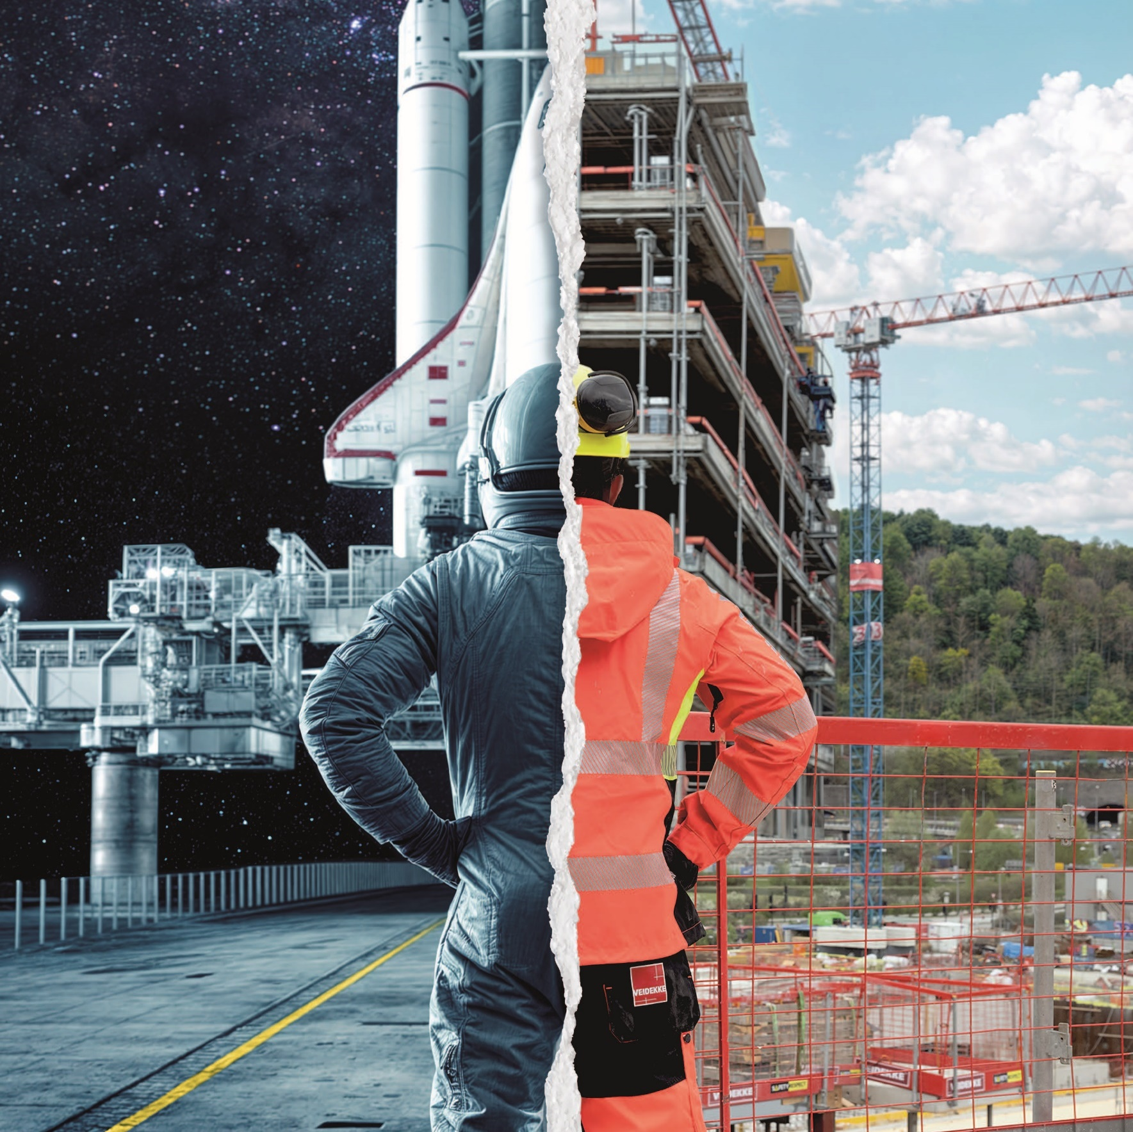
Veidekke’s OHS week 2024:
Safe production
Staff and support functions

Slide 2
Veidekke’s overall OHS goals
No one should become ill, sustain injury or, in the worst case, lose their lives as a result of working at or for Veidekke. Our main priority is to put an end to serious injuries.
An important prerequisite for good OHS work is good production and active involvement of all employees. Veidekke will continuously work to improve the company’s systematic OHS work.
Our workplaces shall be characterised by a high level of well-being, and zero tolerance regarding bullying and harassment. Everyone should be treated equally and with respect.

Slide 3
How do we become good at involving, planning activities and identifying the biggest hazards? The theme of this year’s OHS week is safe production.
During the week, we will take a closer look at how our choices and planning affect safety and the working environment.
We will also talk about how we involve each other in our everyday work and how we create good conditions for safe production.
Veidekke’s OHS week 2024:
Small choices can have big consequences.

Slide 4
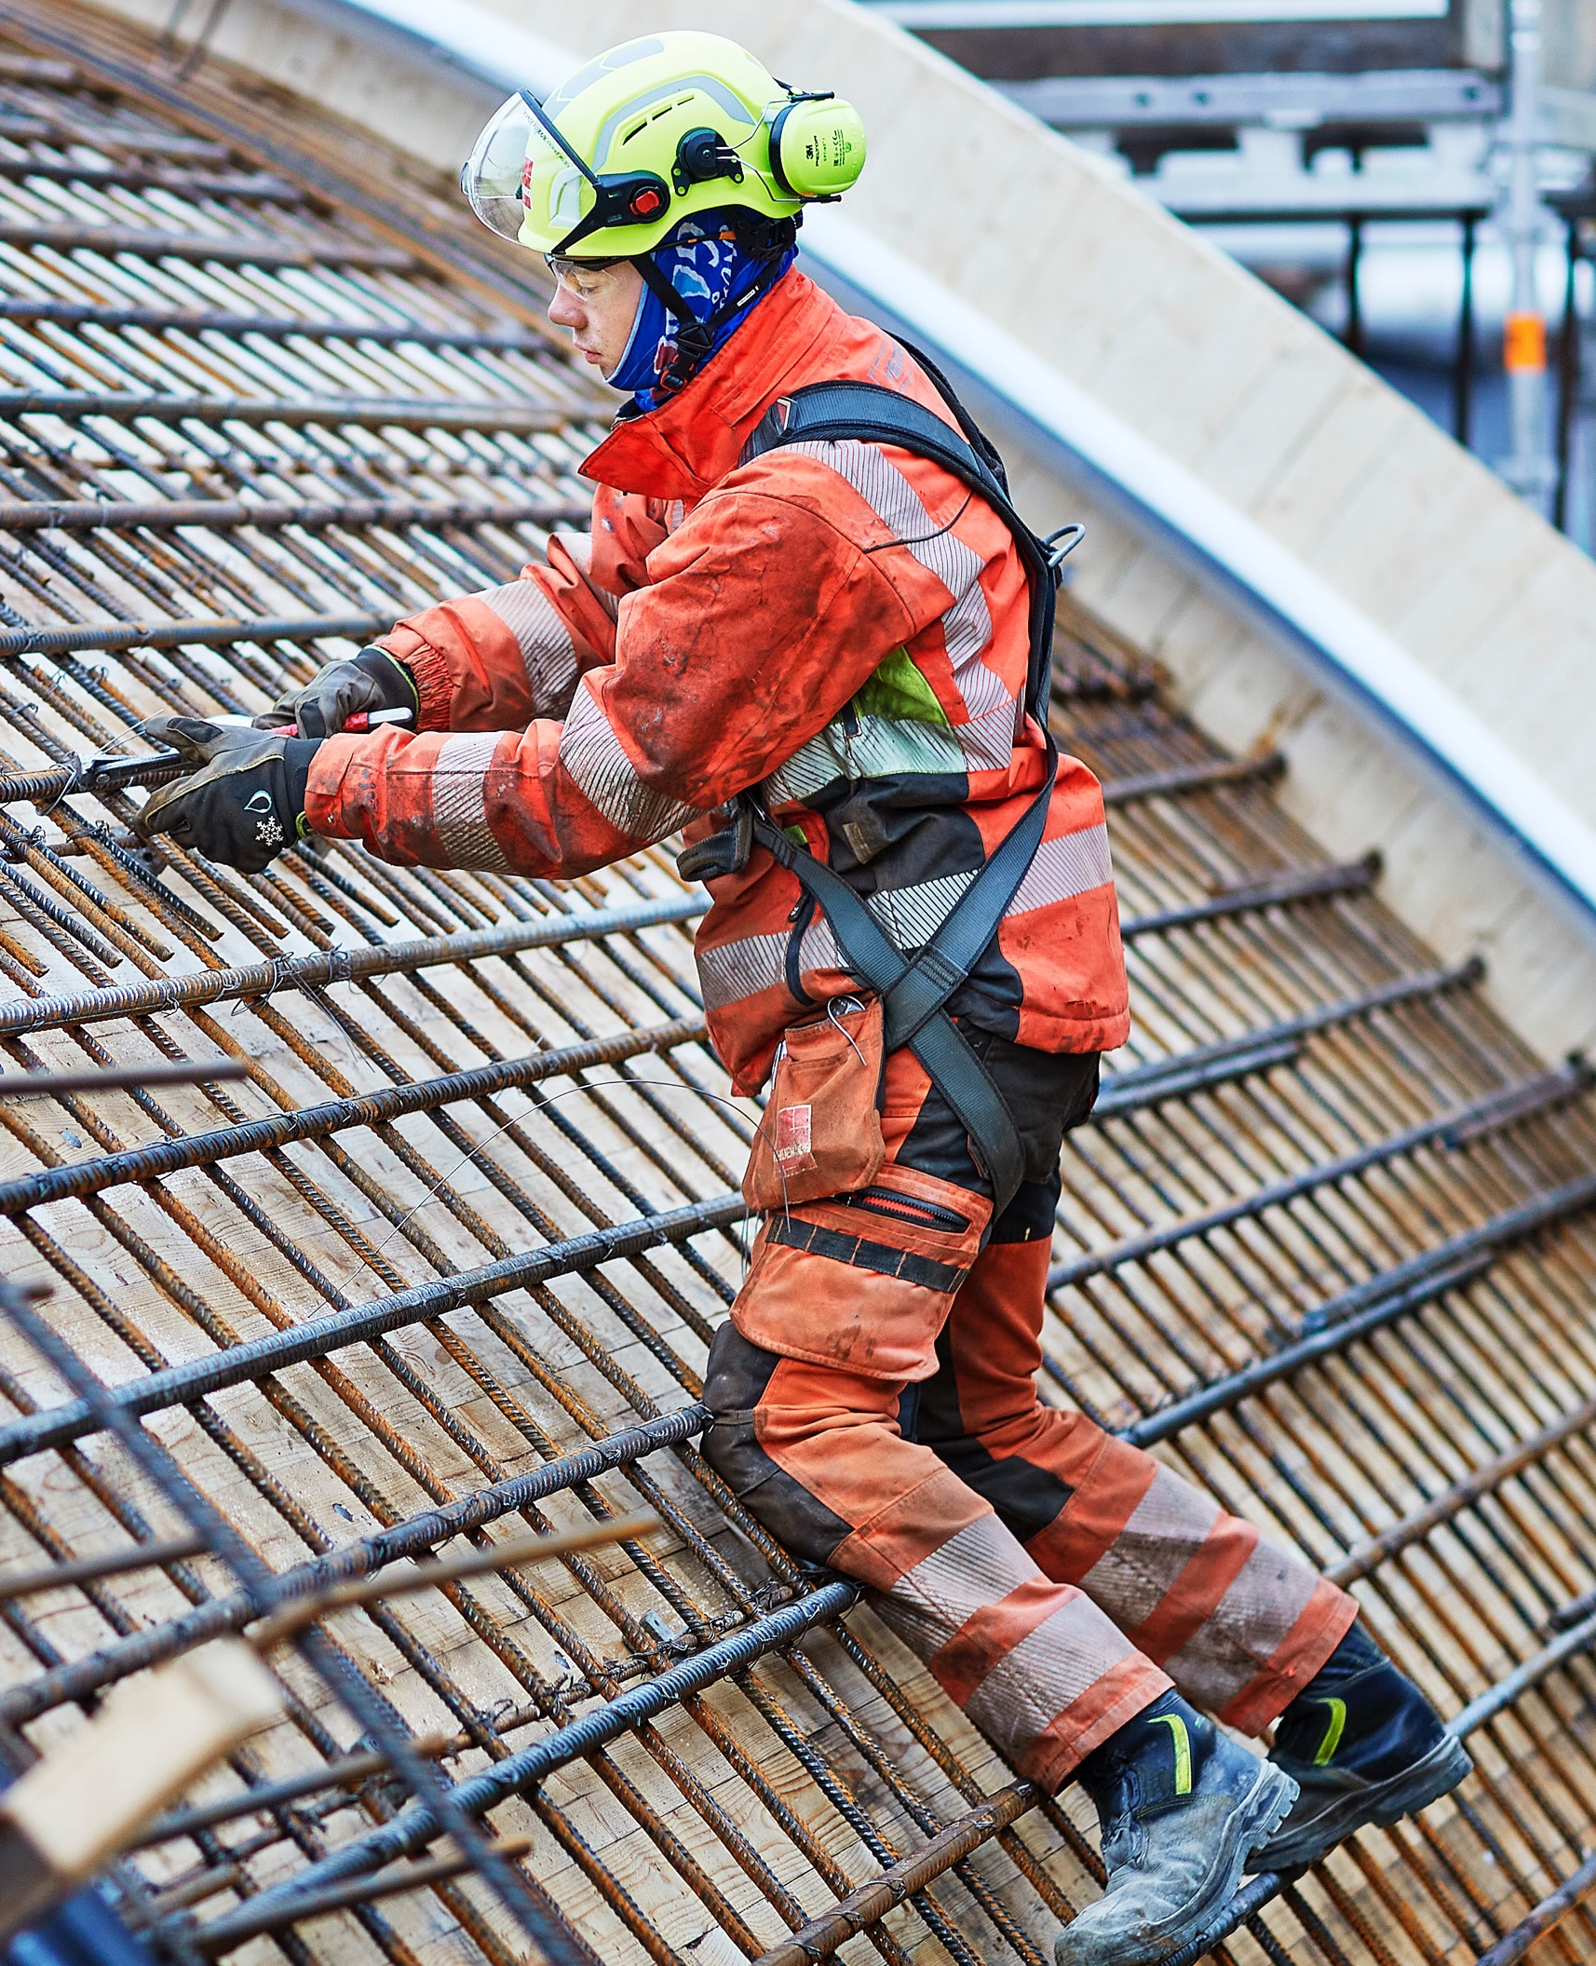
How to conduct a joint programme?
Brief introduction to this year's topic, feel free to use this PowerPoint presentation (5 minutes)
Play this year's OHS film on a large screen, alternatively on your mobile phone (7 minutes)
Go through the discussion tasks in small groups. Get together in groups of two and two or three and three. Then discuss your answers in plenary. (Allow sufficient time – at least 45 minutes)
The joint programme takes approximately 60 minutes to complete altogether.

Slide 5
Watch this year’s OHS week film here

Slide 6
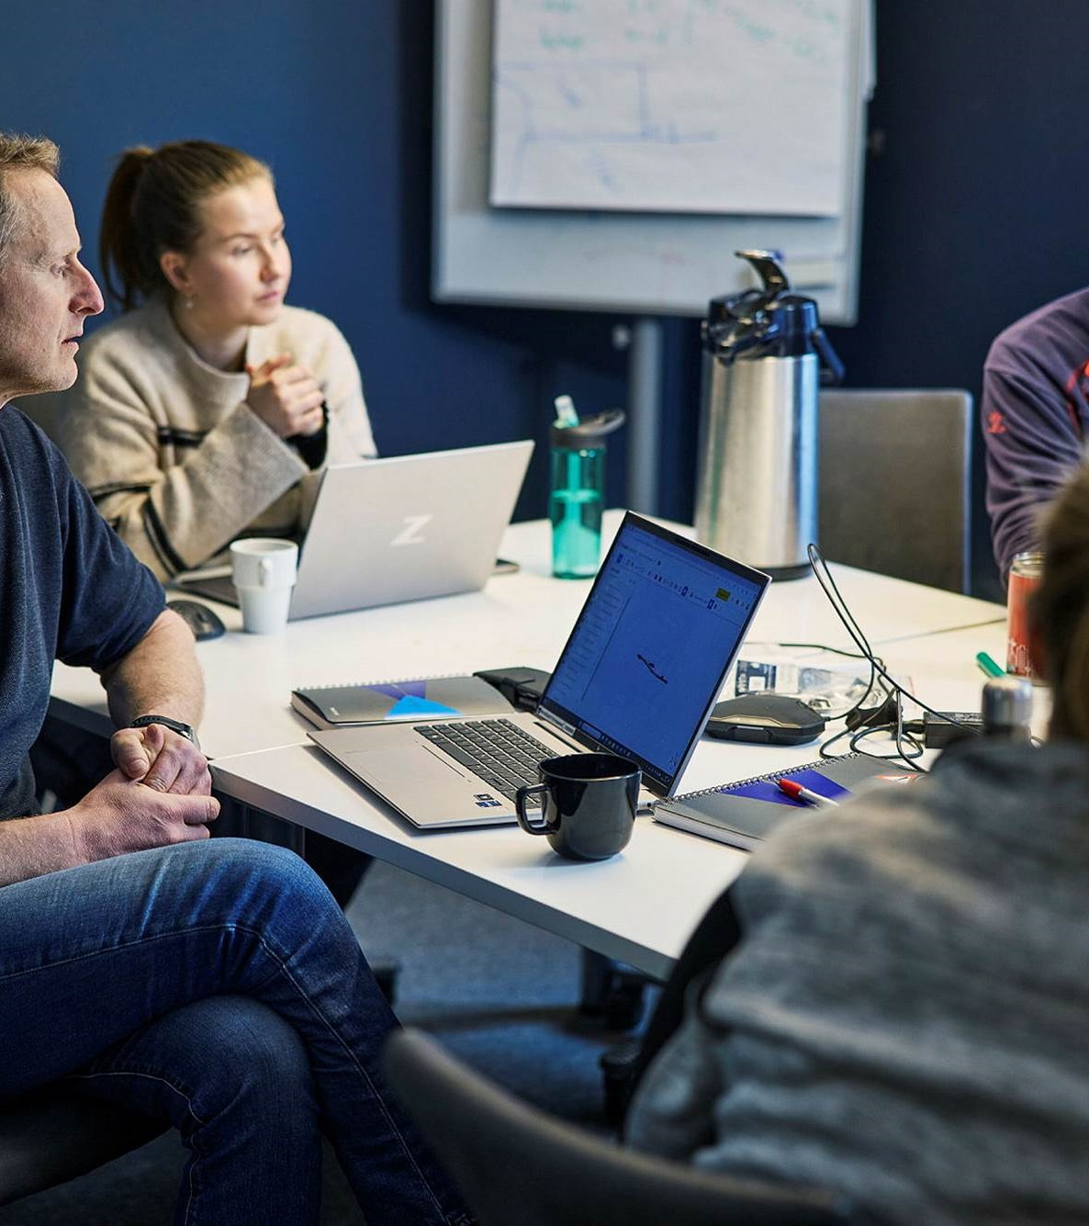
Reflection tasks after the film
Spend enough time on this part, at least 45 minutes
Get together in groups of two and two or three and three
Go through the discussion tasks
Then discuss your answers in plenary
Alt. From Image Bank: Veidekke employees talking to each other

Slide 7
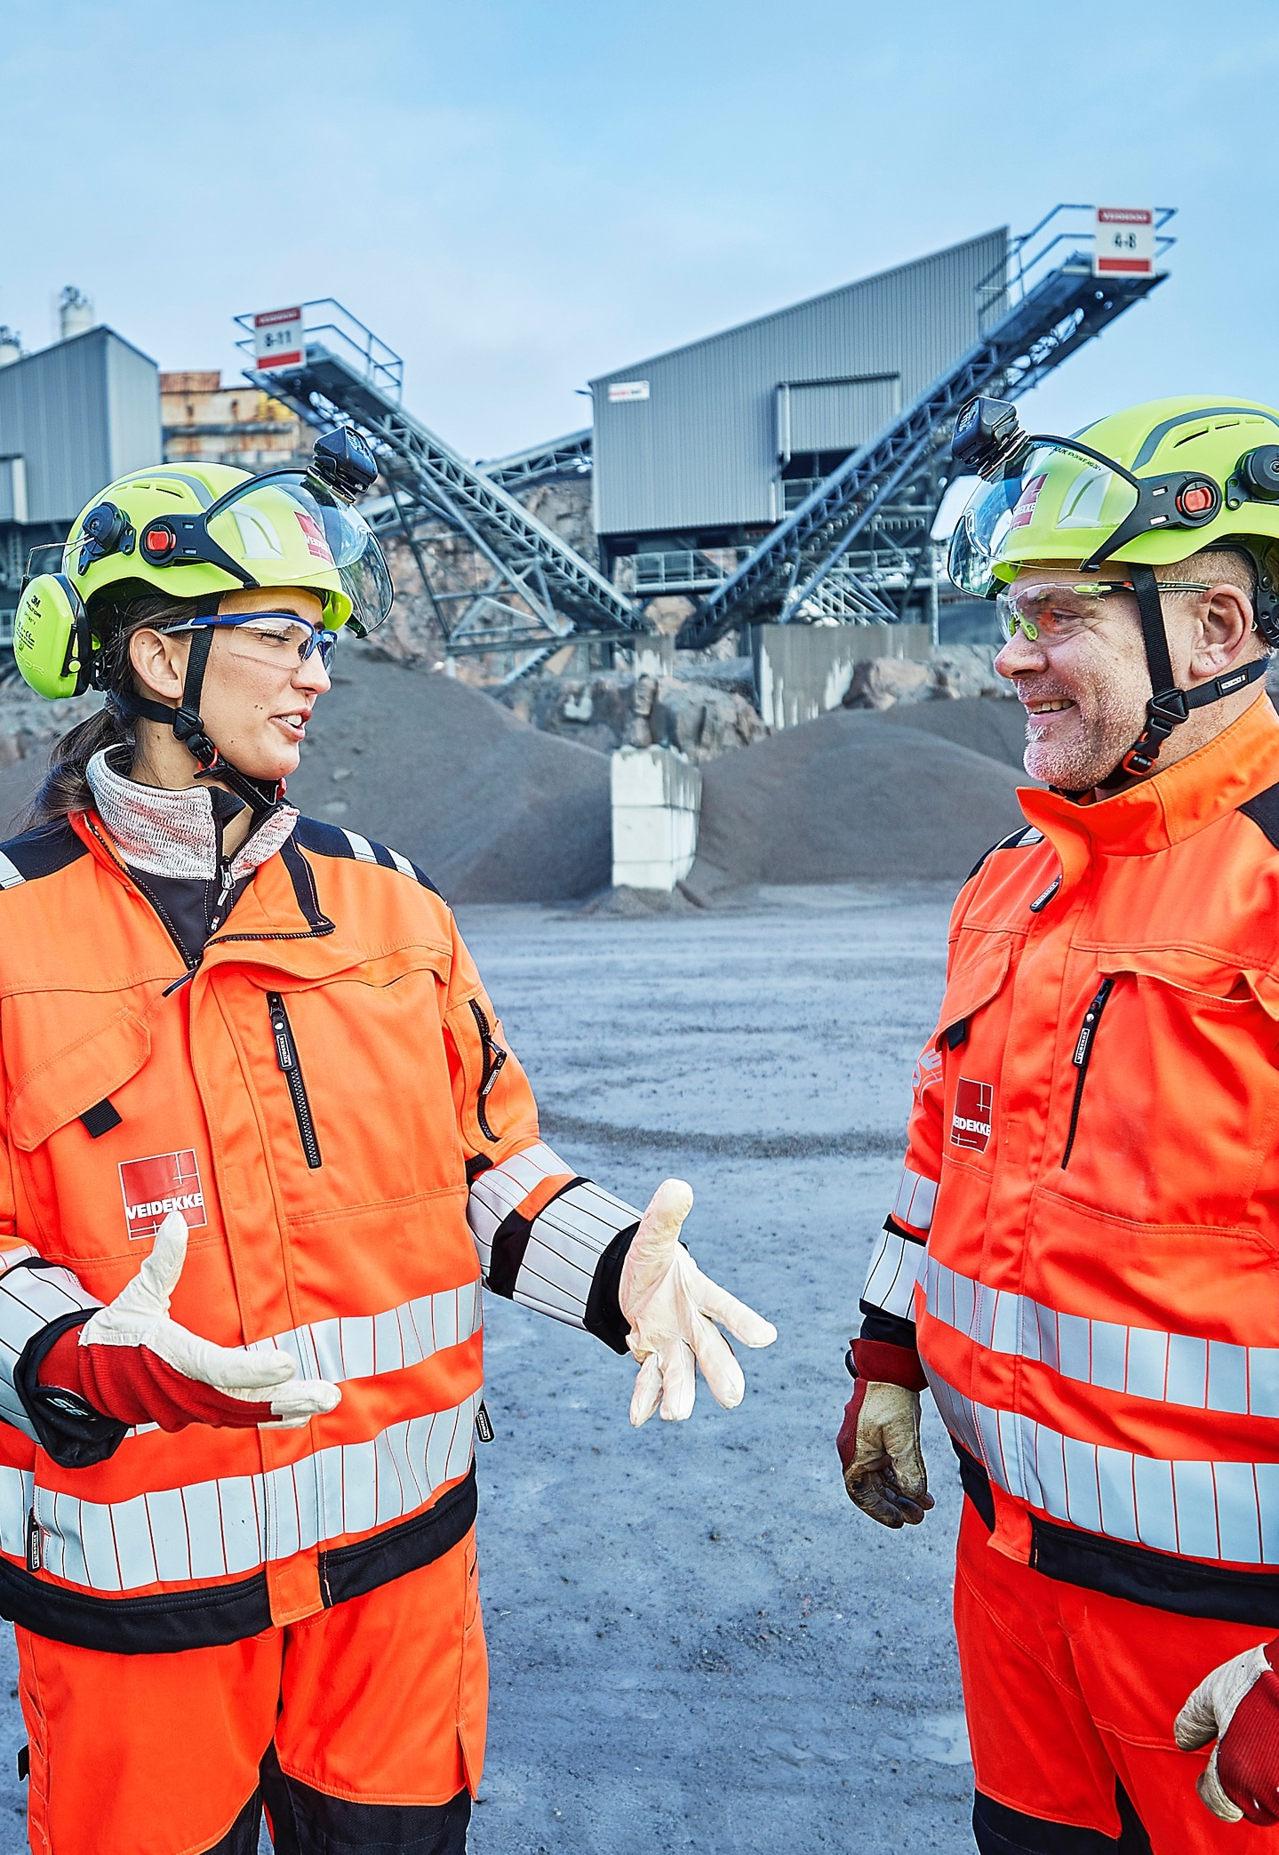
Discussion tasks after the film
Think about what you’re going to do at work this week. Select the questions that are relevant to the group. Please spend approximately 5 minutes per question. Note the answers on post-it notes.
What tasks/projects/processes are you working on this week?
How do you plan for the work to be carried out in a good working environment?
Does your planning impact your safety and working environment in production?
What other competencies/skills should you involve in the planning to detect risk as early as possible? E.g. other support functions, production, safety representative.
Alt. From Image Bank: Veidekke employees talking to each other

Slide 8
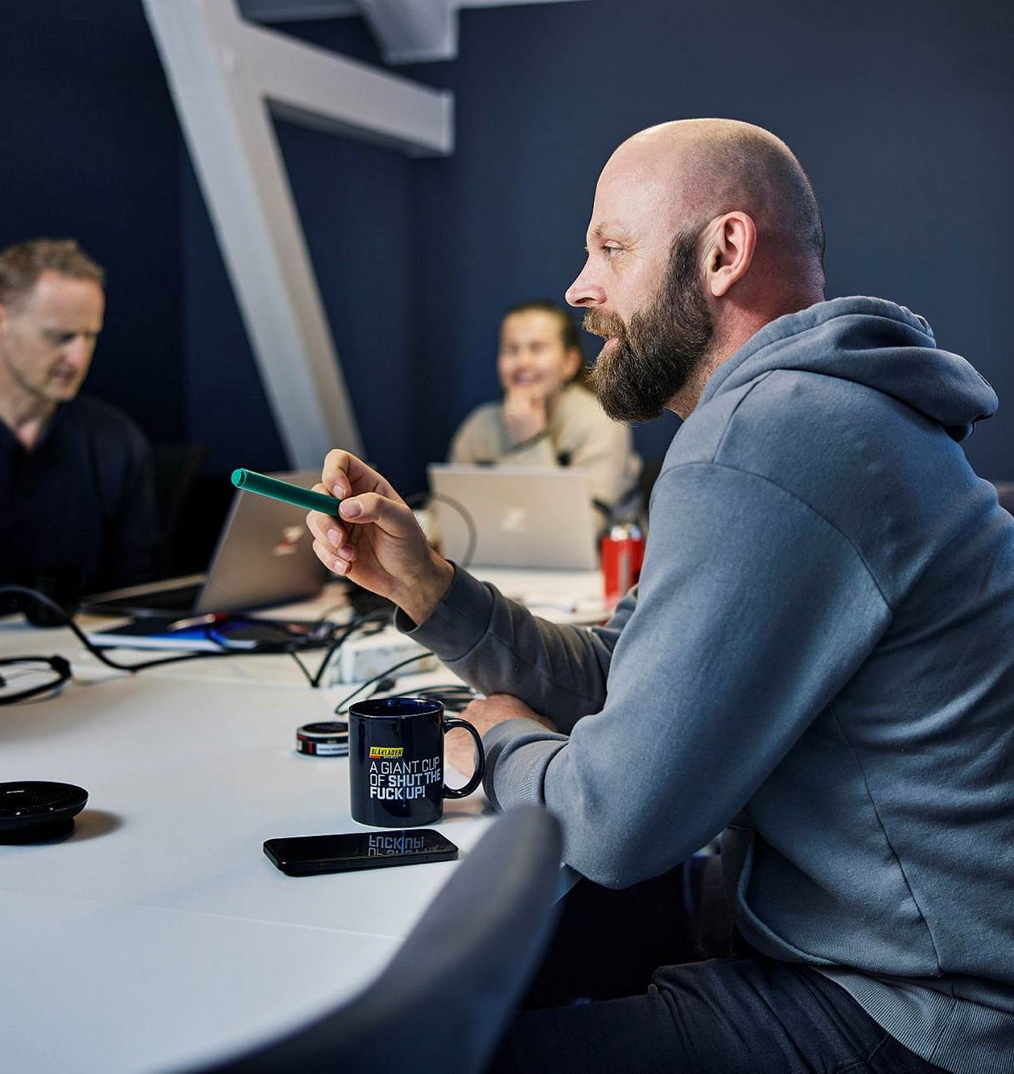
Review all answers with the whole group
What improvement opportunities do you see?
Agree on at least one improvement you will work on.
Add the improvement to the plan if possible. Decide when and how to follow up on this.
Alt. From Image Bank: Group of people from Veidekke having a discussion

Slide 9
Here are suggestions for individual observation tasks that can be done during the other days of Veidekke’s OHS week.
You don’t have to do them all, choose one or two.
Start each day by asking the question to the entire workgroup, asking everyone to keep this in mind throughout the day.
Review the ideas/answers the next day, before starting the next task.
Suggestions for reflection tasks for the next few days

Slide 10
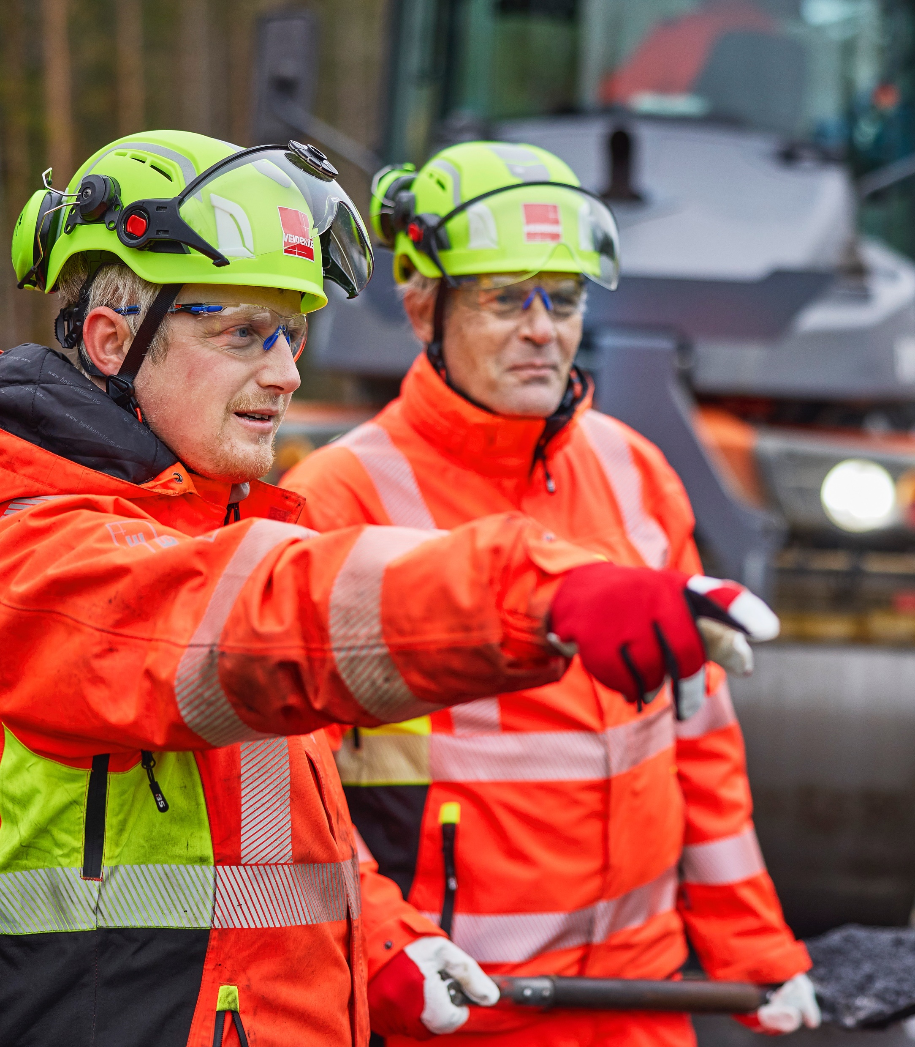
Task 1
Reflect on the climate for speaking freely in the workplace
How do you get everyone involved in planning the work to be done? How does everyone have the opportunity to contribute?
How easy is it to ask questions or raise problems with the people you work with?
Do you have a group agreement? Does it work the way you intended? How do you feel it is being followed?
Alt. From Image Bank: Veidekke employees in different roles talking together

Slide 11
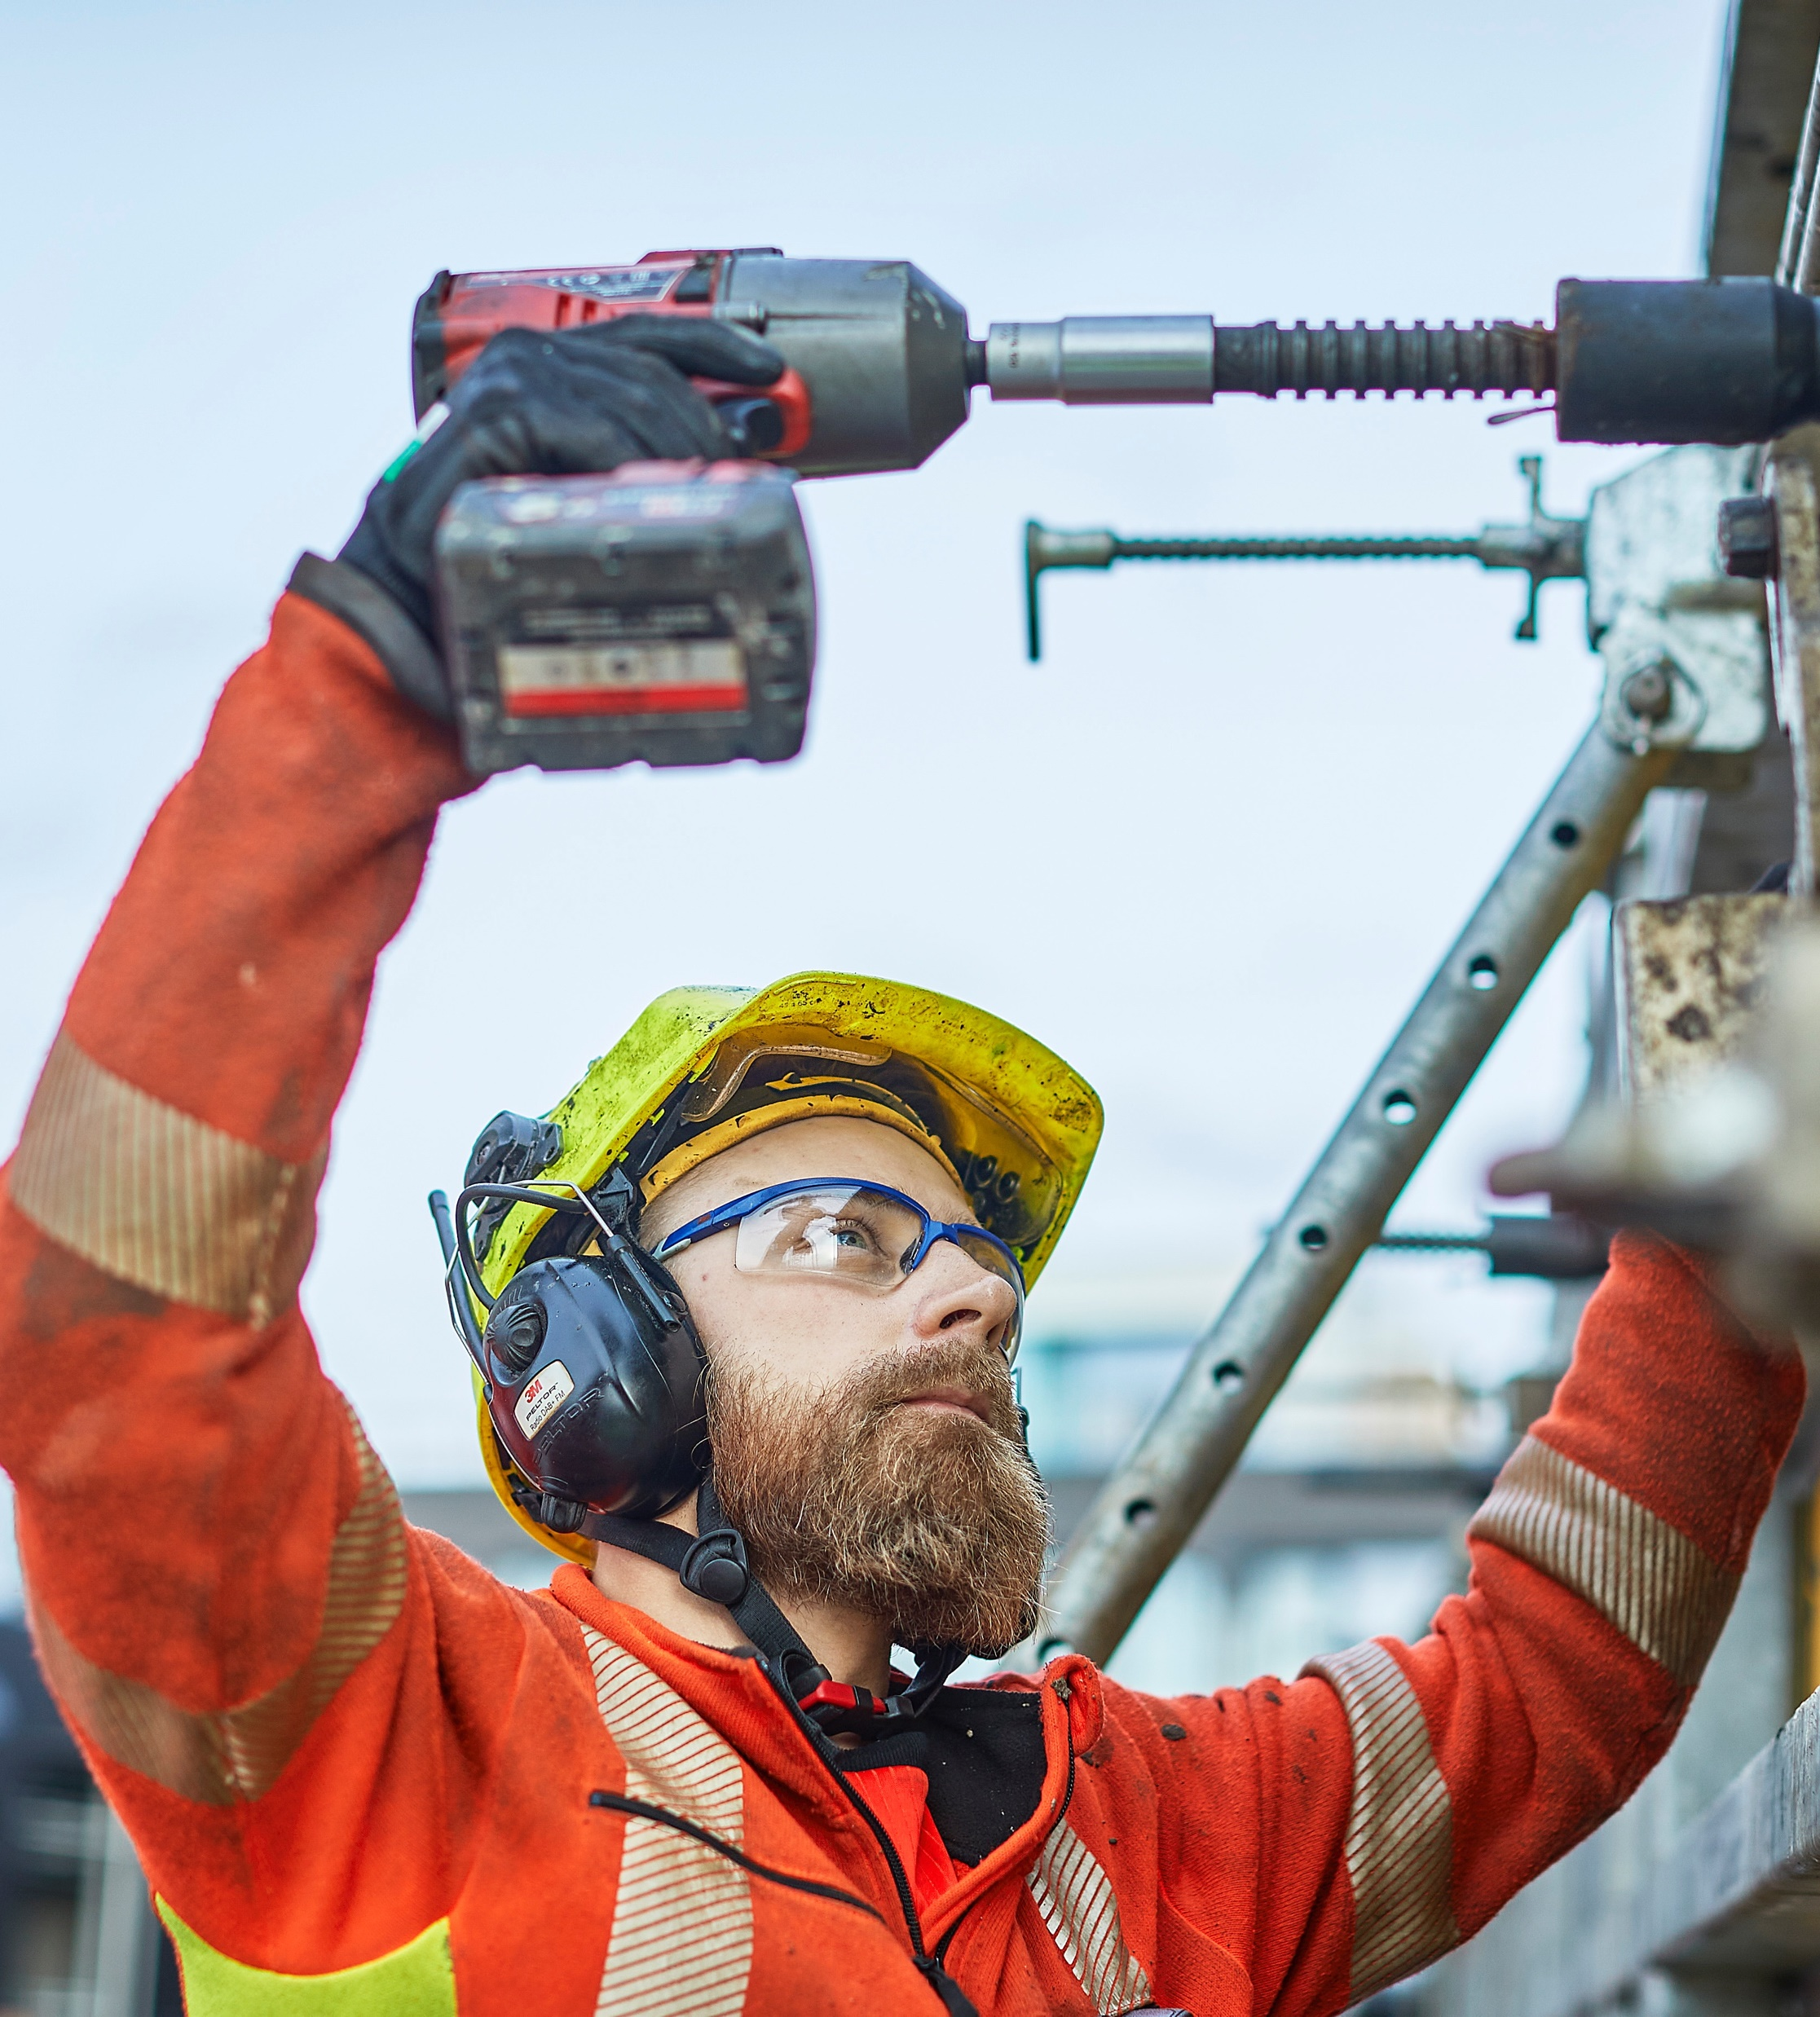
Task 2
The physical work environment
Is there anything in the workplace that makes you tired or weary? E.g. sound level, working position, vision and display, disturbances.
What can be done to improve the physical working environment?
Alt. From Image Bank: Veidekke employees working on a construction site in daylight

Slide 12
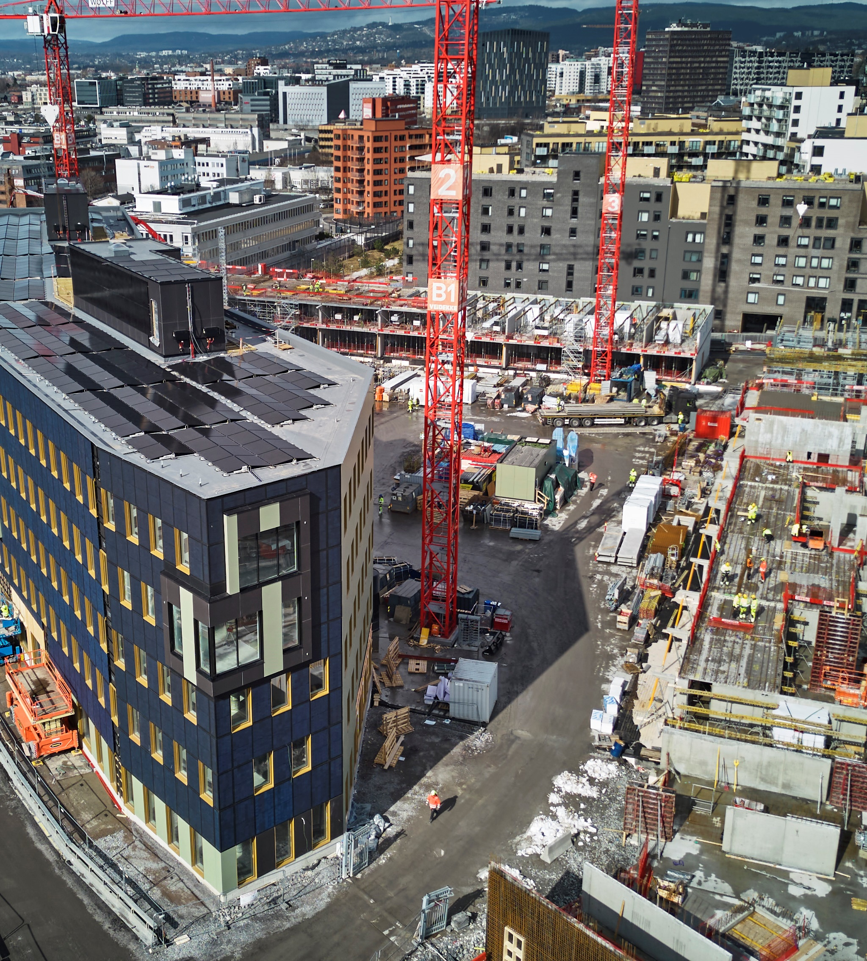
Task 3
This day, we encourage everyone in staff and support functions (who have the opportunity) to schedule a project visit. The visit doesn’t have to happen this day.
During the visit itself:
Discuss with your team if there is anything you can plan or do differently to improve your production safety.
Are there any decisions you are responsible for that may involve workplace risks in the future?
Alt. From Image Bank: Overview of a construction site

Slide 13
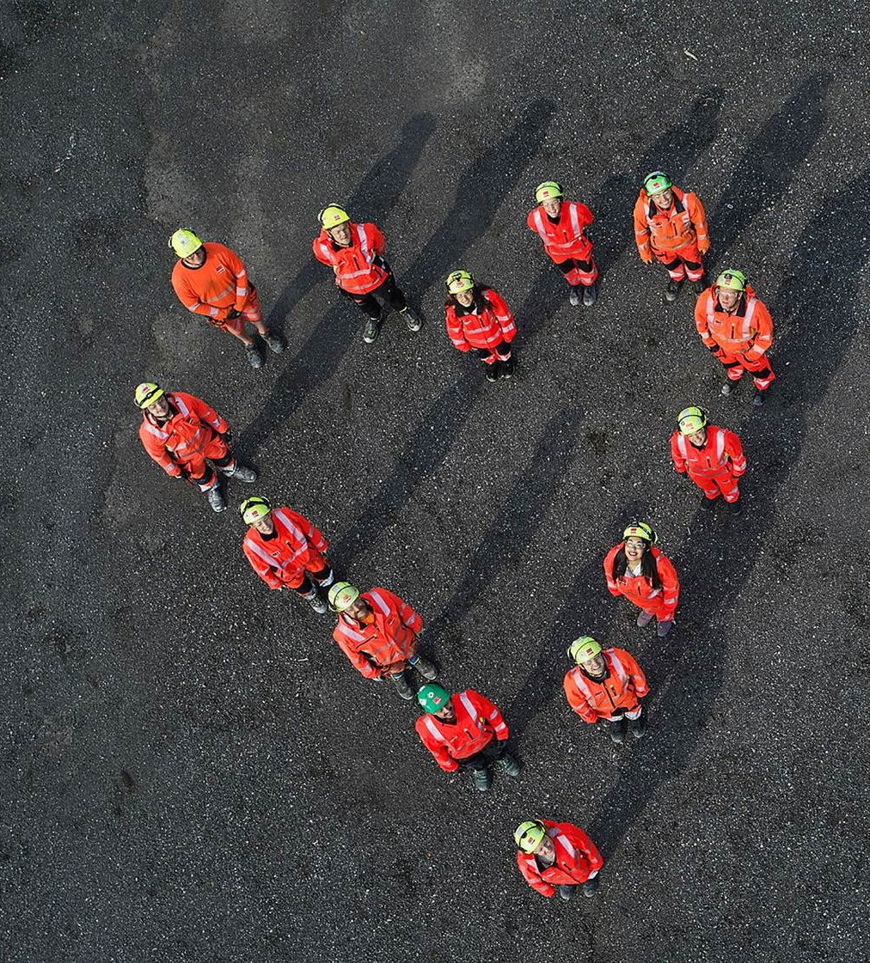
Task 4
Summary of Veidekke’s OHS week
What improvement opportunities do you see? Review the answers with the whole group
Agree on at least one thing to improve and continue to work on. Add it to future planning if possible. Decide when and how you follow this up.
Alt. From Image Bank: Overview of a construction site

Slide 14
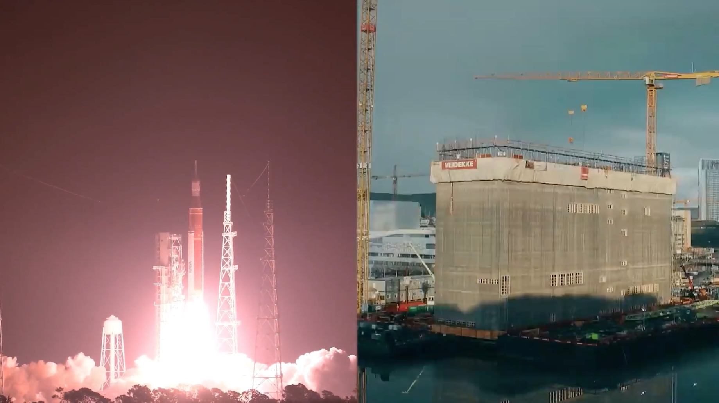

Slide 15
Thank you for

