Slide 1
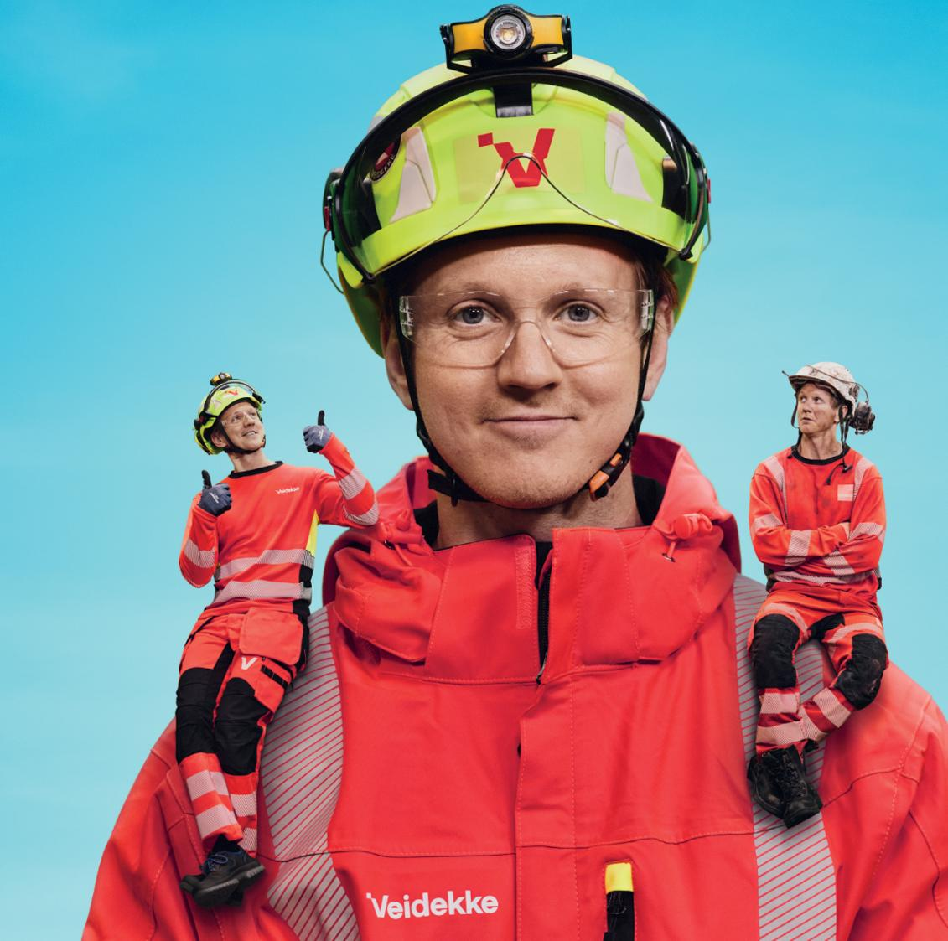
Veidekke’s
HSE week 2025

Slide 2
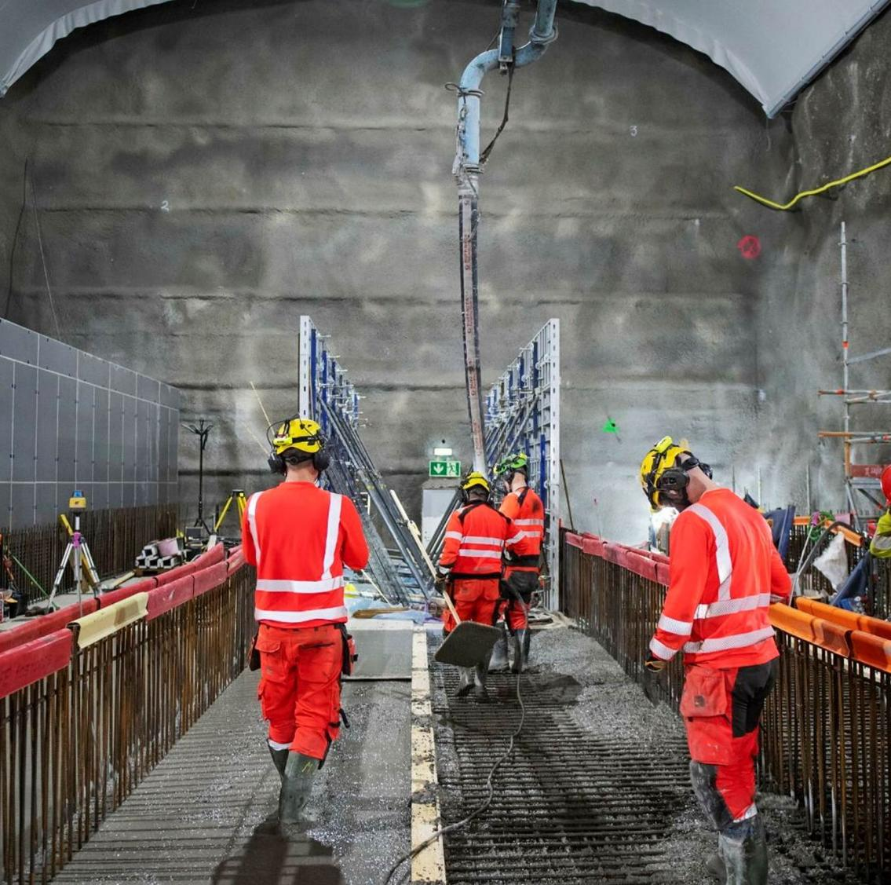
What is Veidekke's HSE week?
Veidekke’s HSE week is an annual event where we focus on topics related to health, safety and the working environment.
The purpose is to enable Veidekke to be a safe and health-promoting workplace.
In HSE week 2025, we will deal with the H and E in HSE, i.e. health and working environment.
Throughout the week, we will reflect on how our choices affect our own health and the health of others, and look specifically at how we can prevent illnesses and ailments.

Slide 3

What are the goals of HSE week 2025?
Prevent illnesses, health issues and musculoskeletal disorders leading to short- and long-term sickness absence
Everyone should be able to retire without work-related illnesses, injuries and ailments.
We want more good working years for everyone

Slide 4
How is the joint programme conducted?
Brief introduction to this year's topic, feel free to use this PowerPoint presentation (7 minutes)
Play this year's HSE film on a large screen, alternatively on your mobile phone (8 minutes)
Go through the discussion tasks in small groups. Get together in groups of two and two or three and three. Then discuss your answers in plenary. (Allow sufficient time – at least 45 minutes)
The joint programme takes approximately 60 minutes to complete altogether.

Slide 5
This year’s topic:
The working environment and occupational health
How can we work in a preventive manner to create a working environment that also contributes to good occupational health?

Slide 6
What do we mean by working environment?
Four subcategories
Psychosocial working environment
How we experience the work situation and content of the work, and the interpersonal interaction at work.
Organisational working environment
  How the work is organised, facilitated and distributed between us as colleagues.
Physical working environment
  How work affects our bodies, both in the short and long term.
Chemical and biological working environment
  Whether we are exposed to chemical and biological substances.
We worked on these issues during the 2022 HSE week
We will be working on these issues in 2025
Notes:
I HMS-uka 2022 tok vi for oss de psykososiale og organisatoriske faktorene som bidrar til å påvirke arbeidsmiljø og vår arbeidshelse.
Tidspress og høyt arbeidstempo
Uklare roller
Mangelfull kommunikasjon
Språklige og kulturelle barrierer
Manglende opplæring

Slide 7
What do we mean by working environment?
During this year’s HSE week, we will identify physical, chemical and biological risk factors that can contribute to impact the working environment and occupational health
Physical risk factors
Noise: Prolonged exposure to high sound levels may result in hearing damage
Vibrations: Particularly from hand-held tools, can lead to hand-arm vibration syndrome
Dust and particles: Quartz dust, asbestos, wood chips. Exposure to dust over time can cause severe lung diseases
Heavy lifting and ergonomic strain (including static and sedentary work): Can lead to musculoskeletal disorders and poor fitness
Chemical and biological risk factors
Exposure to hazardous chemical substances: Exposure to solvents, paints, adhesives and concrete dust can cause contact allergies, skin problems and other more serious diseases

Slide 8
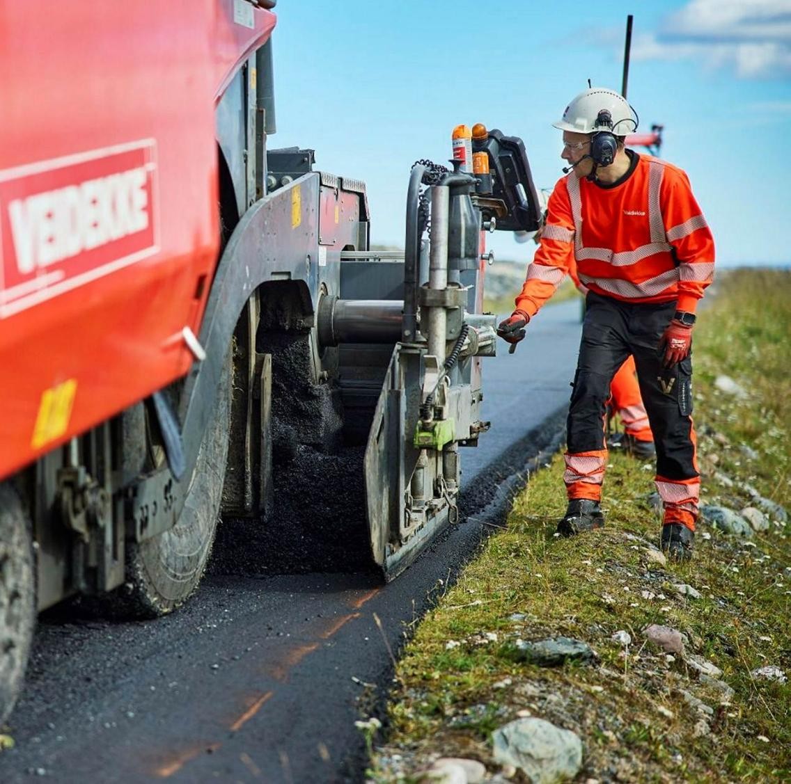
What do we mean by occupational health?
Occupational health is how work affects the health of the individual.
We want Veidekke to be a safe and health-promoting workplace. We make choices every day that can affect our own health and the health of others.
What should we consider – in the short and long term – to prevent musculoskeletal problems and avoid harmful exposure?
How can we work in a preventive manner to create a working environment that promotes health?

Slide 9
Many of the risks associated with wear and illness don’t not become apparent immediately during the work operation.
The impact on the body is only felt after long exposure.

Slide 10
Watch the HSE Week Film together now

Slide 11
Discussion tasks after the film
Go through the discussion tasks in small groups. Get together in groups of two and two or three and three. Then discuss your answers in plenary.
Which physical or chemical risks are you exposed to during your workday? For example, are you affected by noise, dust, chemicals, physical strains, static or sedentary work? How does this affect your health situation in the short and long term?
How can you remove or reduce the risk of illness or repetitive strain injuries in your everyday work? Consider the entire process from planning and procurement to execution.
Which inner voice do you usually listen to? What prevents us from making the right choices when we face situations where we need to choose the approach?
Noise
Vibrations
Dust and particles
Heavy lifting, ergonomic strain, sitting position
Exposure to hazardous chemical and biological substances

Slide 12

Read more about the working environment and occupational health here: hms.veidekke.com

