Slide 1
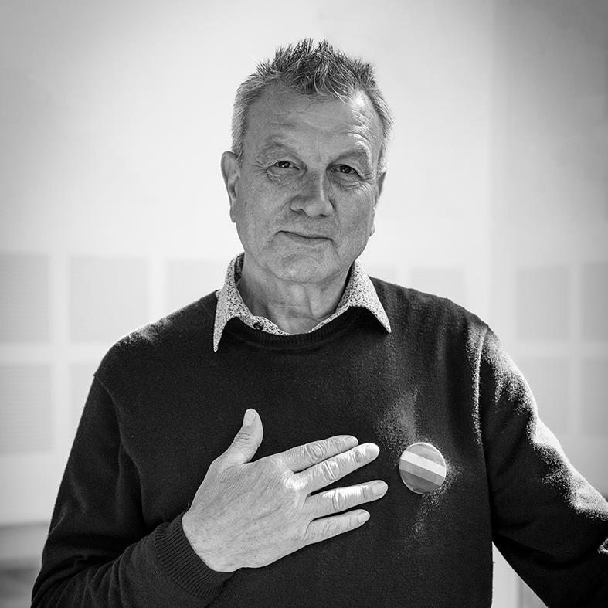
Can you truly be yourself at work?
Veidekke’s OHS Week 2022
Theme: Working Environment

Slide 2
How to implement a joint programme?
Duration: Set aside sufficient time, at least 60 minutes
Introduction to this year’s theme – feel free to use this PowerPoint presentation (10 minutes)
Play this year’s OHS film on the big screen or via a mobile device (10 minutes)
Carry out the reflection exercises through smaller groups of two and two or three and three. Discuss the answers in a plenary session afterwards. (Set aside sufficient time – at least 40 minutes)

Slide 3
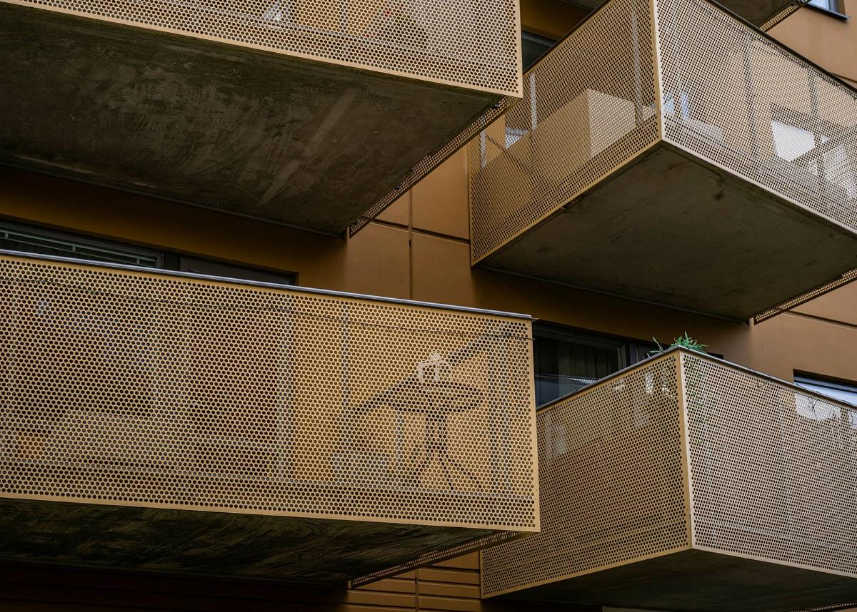
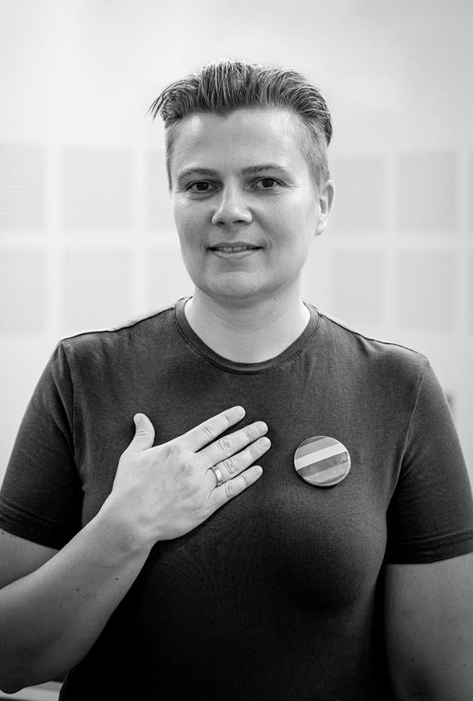
The theme for the 2022 OHS Week is Working Environment
Can you truly be yourself at work?

Slide 4
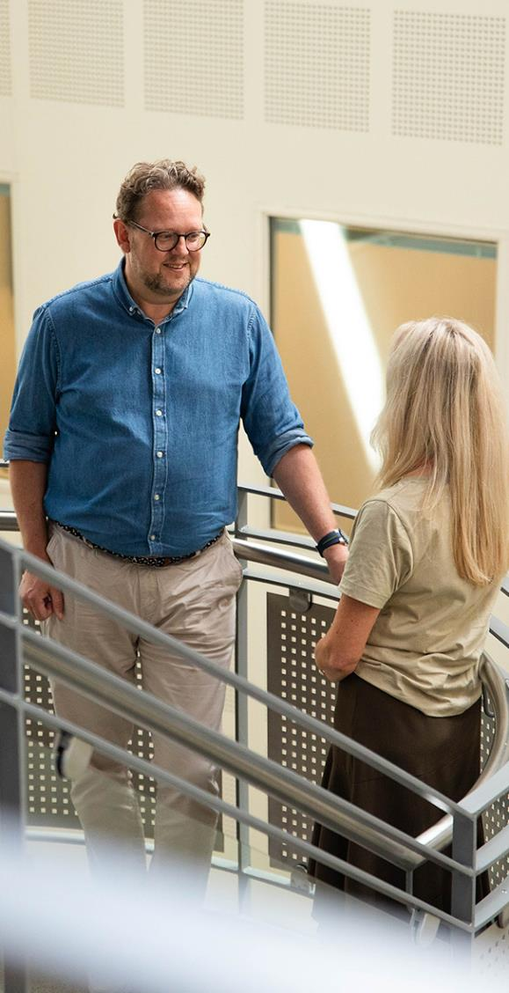
What is working environment?
Working environment refers to the employees’ conditions in a workplace.
Working environment relates to how we organise, plan and carry out work.
These differ from workplace to workplace and require different approaches.
The working environment affects health, job commitment, business performance and productivity.
Source: STAMI and Store norske leksikon

Slide 5
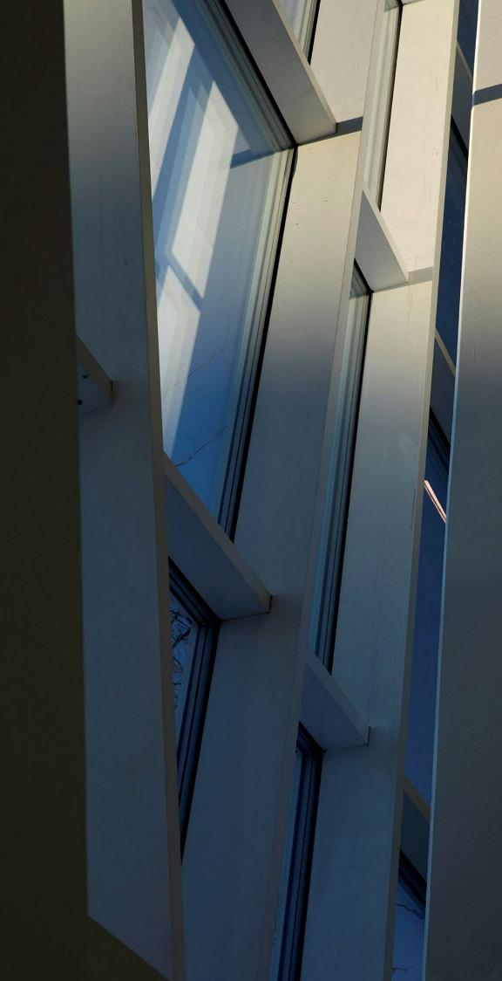
The working environment can be broken down into four sub-items
Psychosocial working environment
  How we perceive our work situation and the content of our work, as well as interpersonal interactions at work.
Organisational working environment
  How the work is organised, adapted and distributed between colleagues.
Physical working environment
  How work affects our bodies, in both the short-term and the long-term.
Chemical and biological working environment
  If we are exposed to chemical and biological substances.

Slide 6
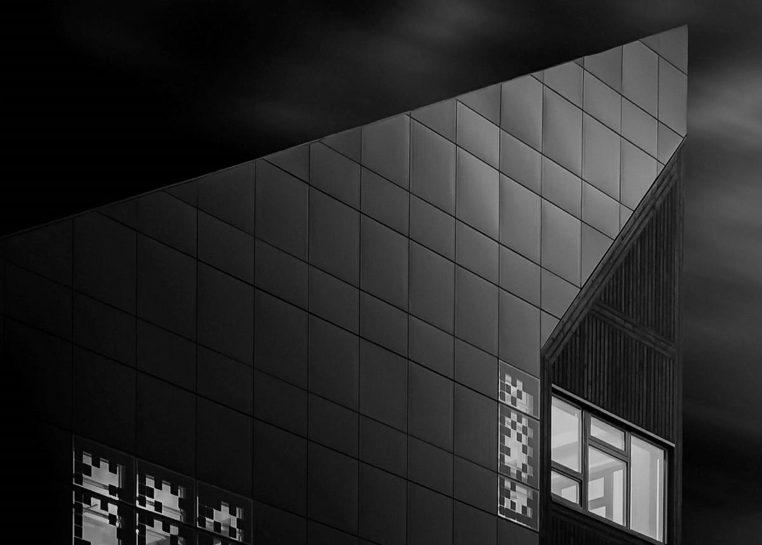
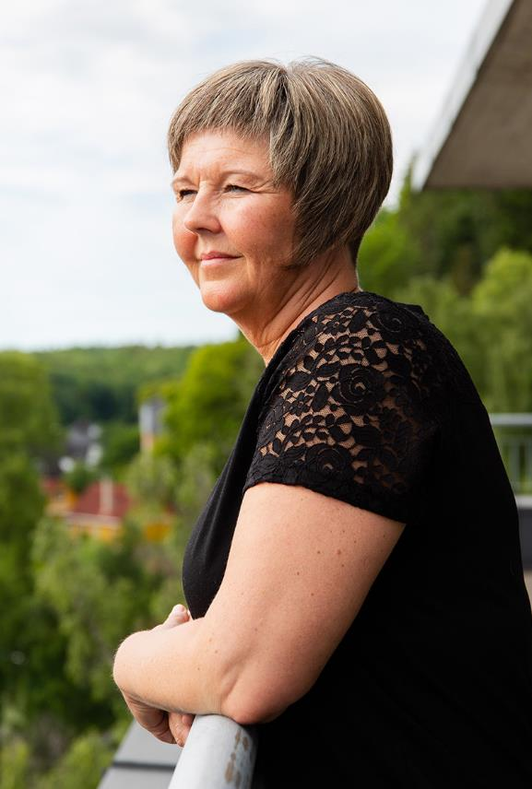
All of these areas influence health, absence and dropout from working life. It is therefore crucial that we work preventively and systematically on all of these items.

Slide 7
This year, we will take a closer look at the following two sub-items
Psychosocial working environment
  How we perceive our work situation and the content of our work, as well as interpersonal interactions at work.
Organisational working environment
  How the work is organised, adapted and distributed between colleagues.
Physical working environment
  How work affects our bodies, in both the short-term and the long-term.
Chemical and biological working environment
  If we are exposed to chemical and biological substances.

Slide 8
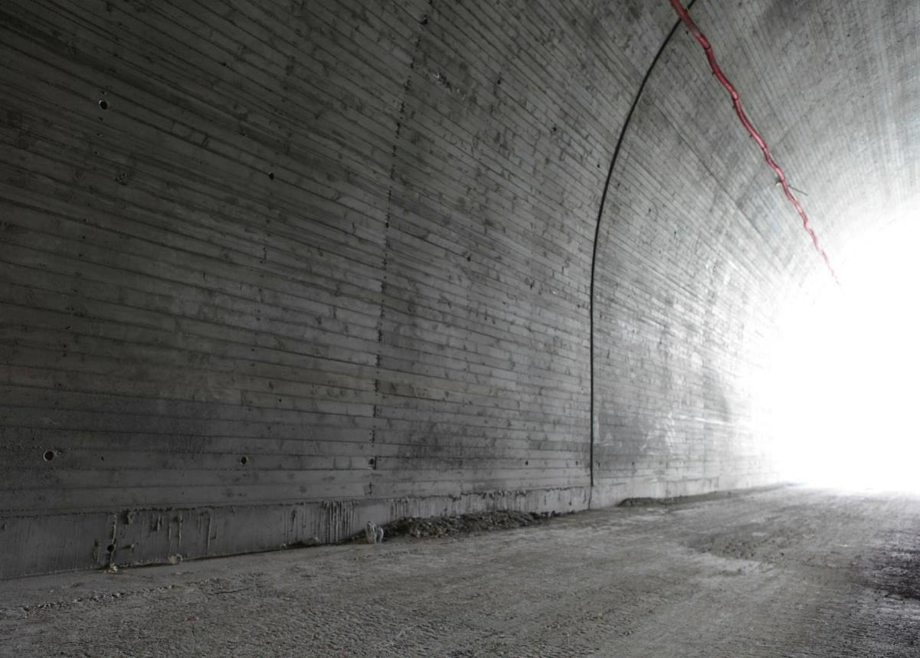
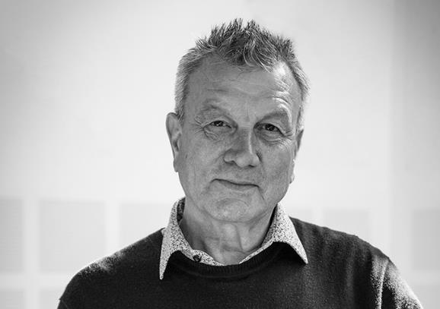
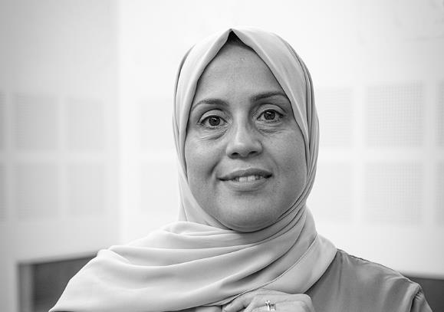
Can you truly be yourself at work?

Slide 9
Play film

Slide 10
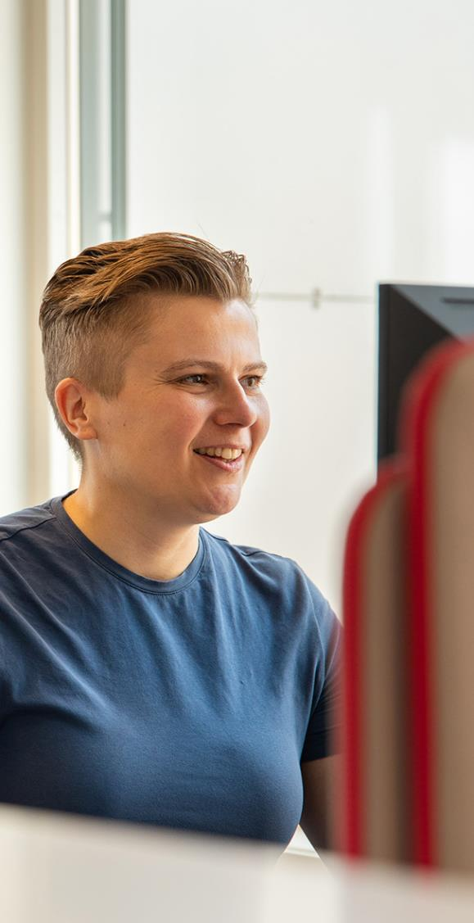
Reflection exercises after the film
Set aside adequate time for this element, at least 40 minutes
Work together in groups of two and two or three and three
Carry out the reflection exercises
Discuss the answers in a plenary session
The purpose of the reflection exercises is for us all to think about what constitute good working environment initiatives and what influences our physical and mental health during the working day.

Slide 11
Reflection exercises
What does it take for you to have a good day at work? Describe the features of a good working day for you.
How can you contribute to ensuring that those around you can truly be themselves at work?
How can planning, adaptation and organisation be improved to strengthen your working environment?
Is there anything else that can be reinforced and/or improved within your working environment?

Slide 12
Thank you

